Slide 1
MONEY MAP
Financial (Expense) Management Application
GROUP 15:
SARAH SIDDIQUI (25BCE10451)
JIYA KALRA (25BAI10733)
SANSKRUTI CHANEKAR (25BAI10603)
SNEHA SINGH (25BCE10614)
CH INDUSHYA (25BHI10081)

Slide 2
Problem Statement & Objective In today’s fast-paced world, managing money through notes or spreadsheets leads to confusion and missed savings goals. The objective is to build a smart digital solution that tracks every rupee effortlessly.
Why We Need an Expense Management App Because financial clarity should be simple. The app brings all income, expenses, and categories together in one place—turning chaos into control.
Real-Life Purpose & Benefits
Keeps your budget organized and transparent.
Identifies spending patterns to boost savings.
Offers instant summaries and visual insights.
Acts as your personal finance assistant—anytime, anywhere.

Slide 3
PROJECT FEATURES
01
02
COMPLETED
IN PROCESS
1)Add
2)Update
3)Delete
1)Categorization
2)View summaries and reports
03
04
PYTHON 3
VS Code
Command line
YET TO START
TECHNOLOGY USED
Data storage
Search option

Slide 4
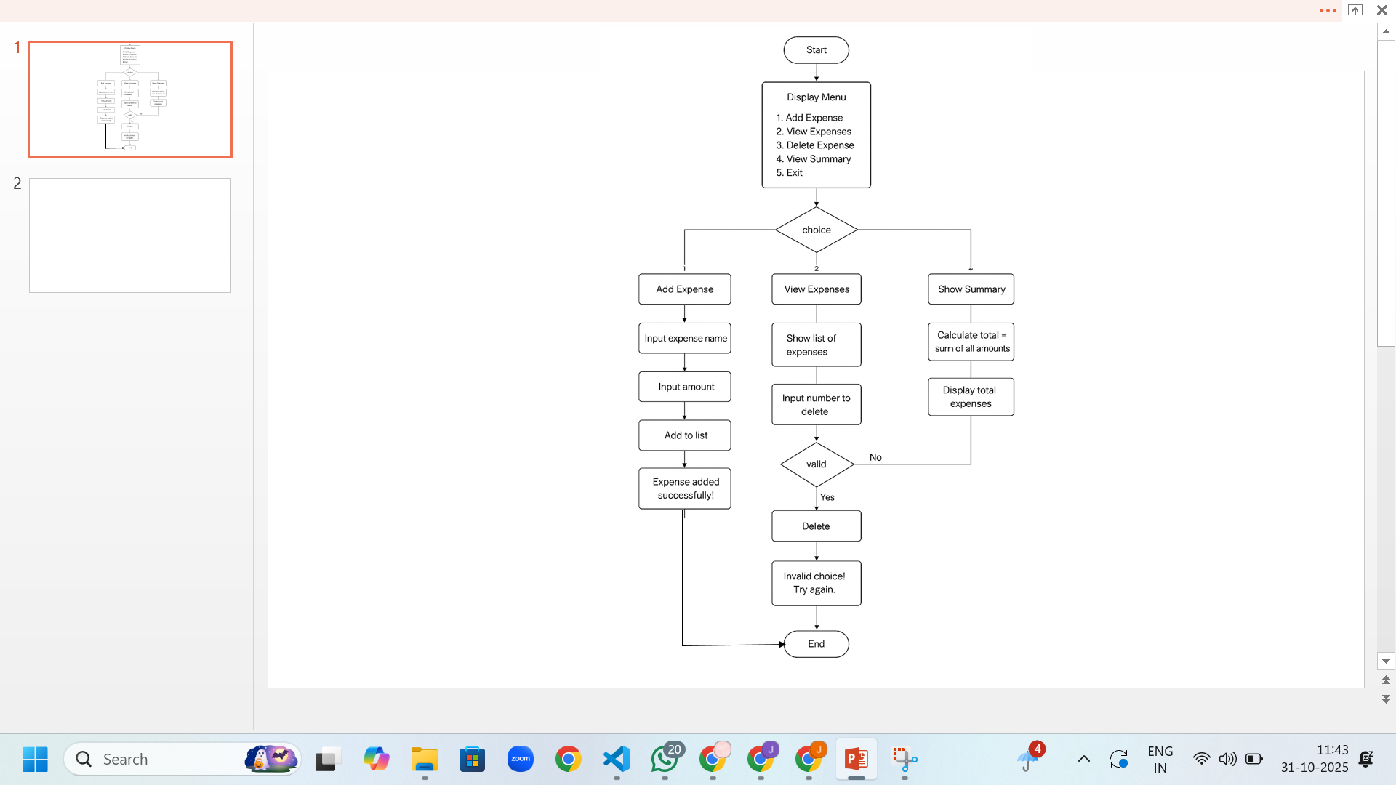
SYSTEM DESIGN
FLOWCHART :

Slide 5
CODE

Slide 6
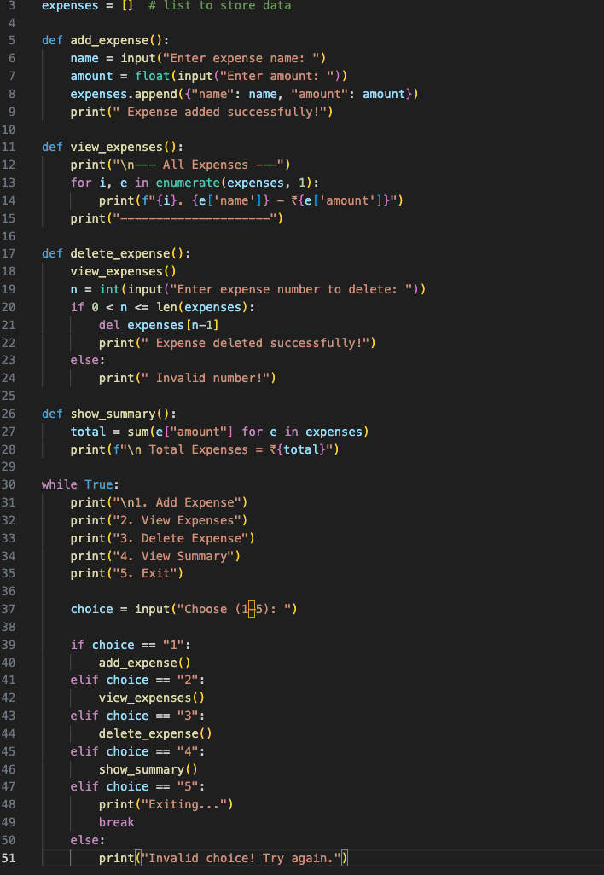

Slide 7
OUTPUTS

Slide 8
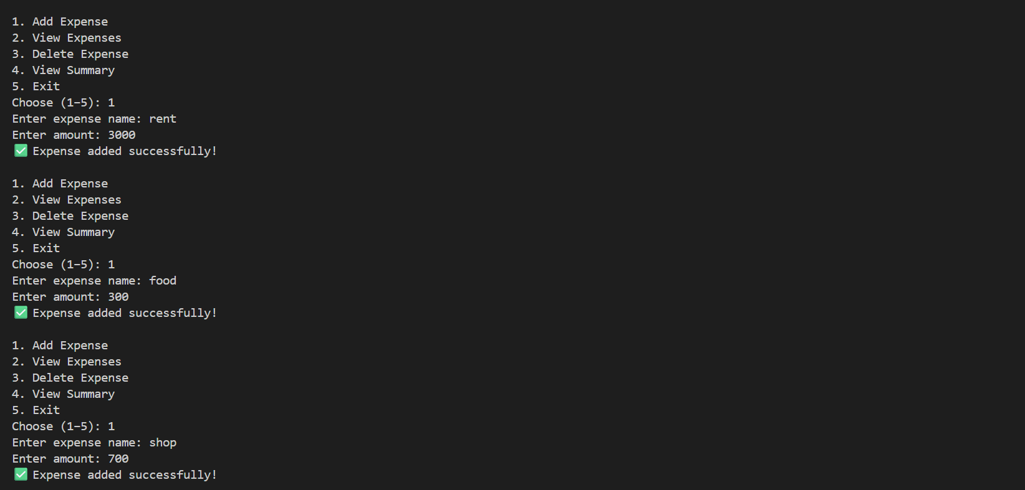
Adding Expenses

Slide 9
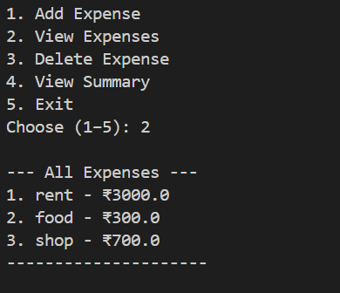
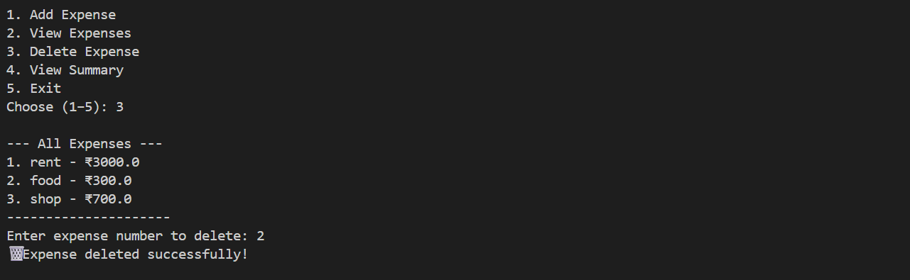
View expense
Delete Expense

Slide 10
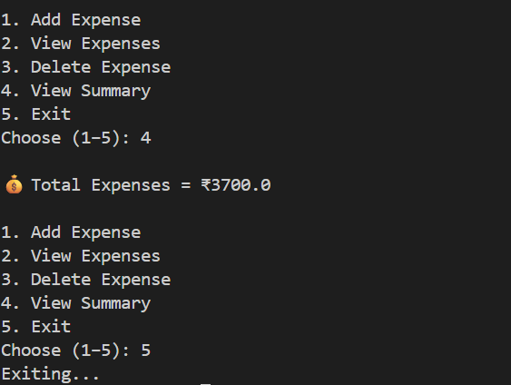
Summary and Exiting:

Slide 11

CHALLENGES FACED
1)Managing volatile in - memory data
2)Validating inputs
3)Maintaining program flow and output formatting.
4)Coordinating tasks and responsibilities within members.
MONEYMAP

Slide 12
Thanks!
]]

